Slide 1
Module 2:
Control Structures in C

Slide 2
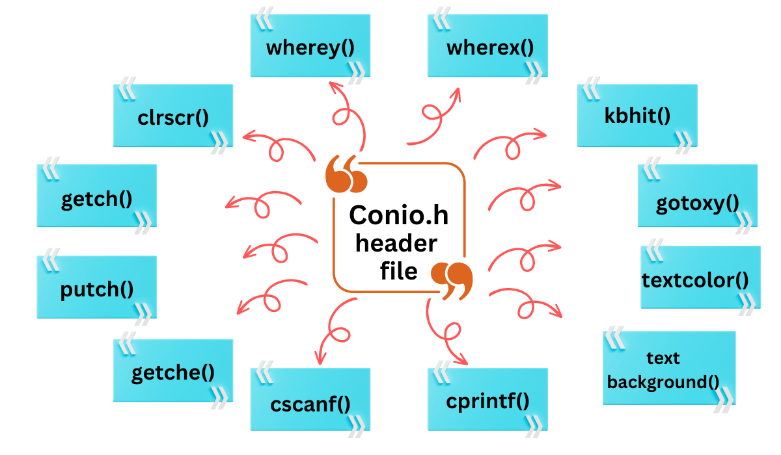
Control Structures in C
Conditional Branching Statements in C:
1. Simple if statement
2. if… else statement
3. Nested if…else statement
4. else…if ladder
The ‘conio.h’ header file is a C library that provides functions for handling console input and output operations. It is a non-standard C header file i.e., it is not part of the official C language specification. It is not supported by modern compilers such as GCC.
https://www.codingninjas.com/

Slide 3
clrscr()
You can use this function to clear the output screen.
getch()
This function can get a single-character user input from the console.
putch()
The putch() function prints a single character on the output screen.
getche()
You can use this function to get alphanumeric values. It displays the character that is provided as input and reflects the character on the screen.

Slide 4
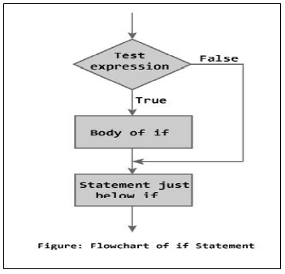
Control Structures in C
Conditional Branching Statements in C:
Simple if statement
Syntax:
if(test-expression/condition)
{
True statement-block ;
}
statement-x;

Slide 5
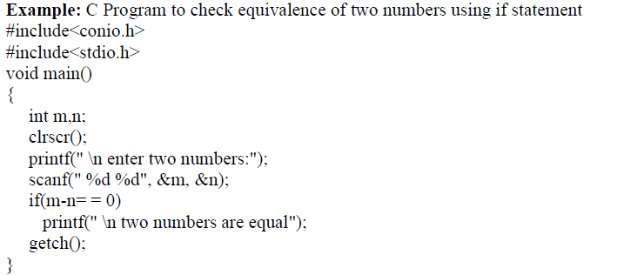
Control Structures in C
Conditional Branching Statements in C:
Simple if statement

Slide 6
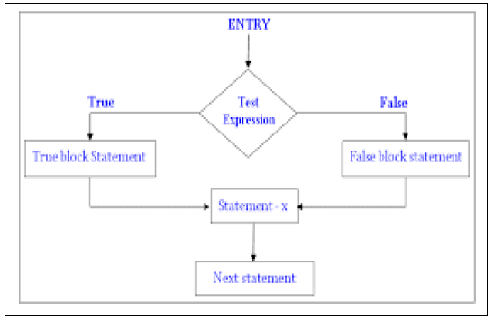
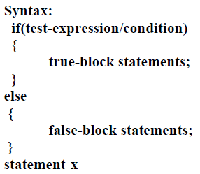
Control Structures in C
Conditional Branching Statements in C:
1. Simple if statement
2. if… else statement

Slide 7
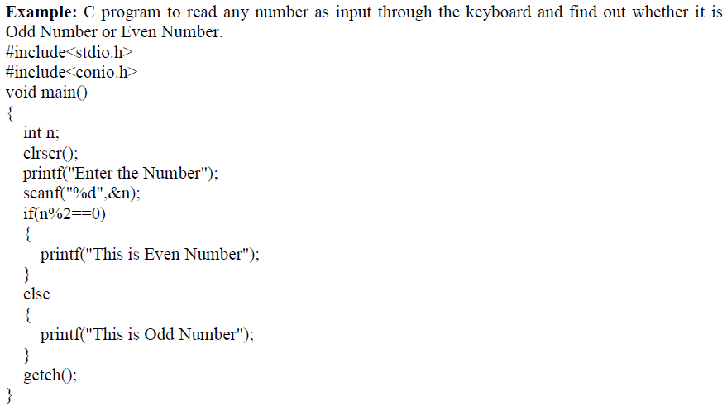
Control Structures in C
Conditional Branching Statements in C:
1. Simple if statement
2. if… else statement

Slide 8
Control Structures in C
Conditional Branching Statements in C:
1. Simple if statement
2. if… else statement

Slide 9
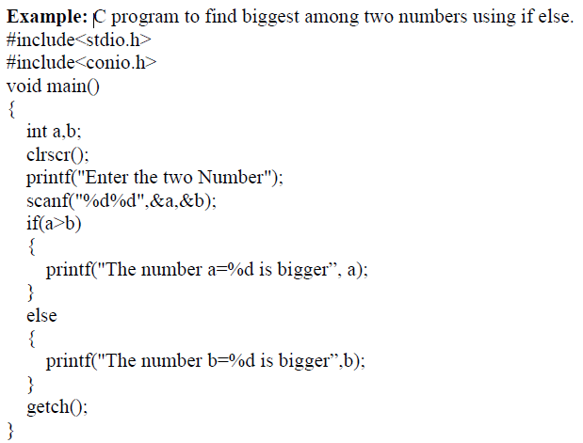
Control Structures in C
Conditional Branching Statements in C:
1. Simple if statement
2. if… else statement

Slide 10
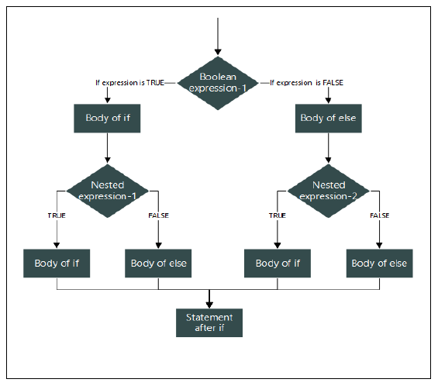
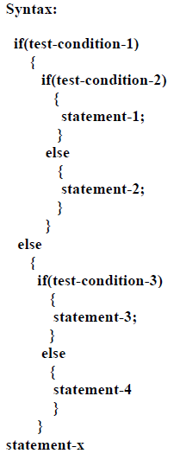
Control Structures in C
Conditional Branching Statements in C:
1. Simple if statement
2. if… else statement
3. Nested if…else statement

Slide 11
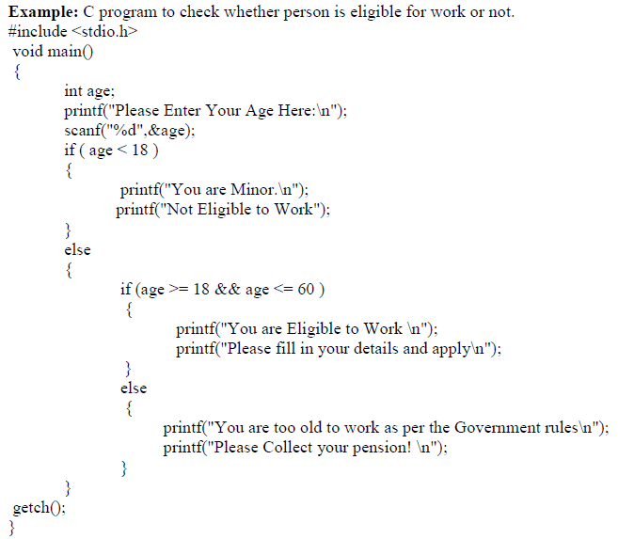
Control Structures in C
Conditional Branching Statements in C:
1. Simple if statement
2. if… else statement
3. Nested if…else statement

Slide 12
Control Structures in C
Conditional Branching Statements in C:
1. Simple if statement
2. if… else statement
3. Nested if…else statement
If age <18….Minor and not eligible
If age >=18 and age <=60 eligible
Else You are too old to work

Slide 13
Control Structures in C
Conditional Branching Statements in C:
1. Simple if statement
2. if… else statement
3. Nested if…else statement

Slide 14
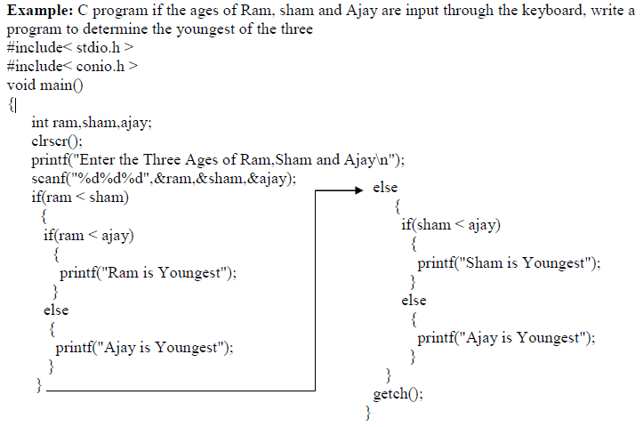
Control Structures in C
Conditional Branching Statements in C:
1. Simple if statement
2. if… else statement
3. Nested if…else statement

Slide 15
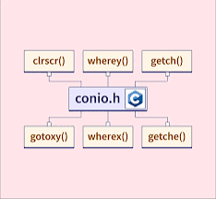
Control Structures in C
Conditional Branching Statements in C:
1. Simple if statement
2. if… else statement
3. Nested if…else statement
conio. h is a header file in which there are many built-in functions embedded in it they generally perform input/output on the console i.e., it is used to take input from the keyboard given by the user and display output on the screen.

Slide 16
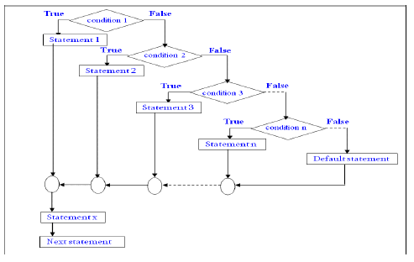
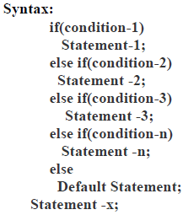
Control Structures in C
Conditional Branching Statements in C:
1. Simple if statement
2. if… else statement
3. Nested if…else statement
4. else…if ladder

Slide 17
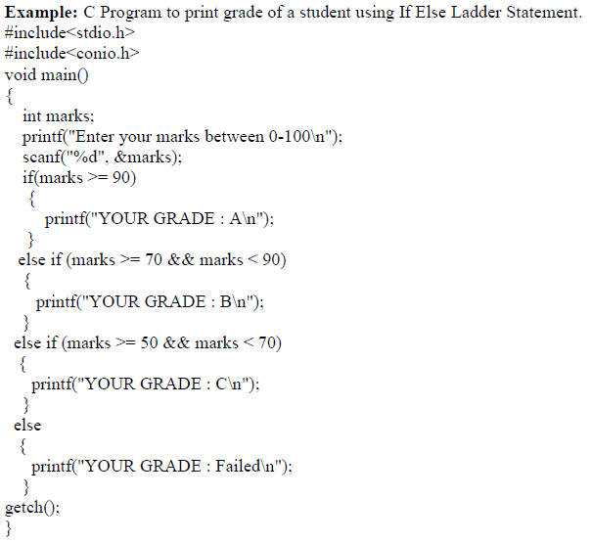
Control Structures in C
Conditional Branching Statements in C:
1. Simple if statement
2. if… else statement
3. Nested if…else statement
4. else…if ladder

Slide 18
Control Structures in C
Conditional Branching Statements in C:
1. Simple if statement
2. if… else statement
3. Nested if…else statement
4. else…if ladder
If marks >90….A grade
If marks >=70 and marks <=90…B grade
If marks >=50 and marks <70…C grade
Else You are Fail

Slide 19
Control Structures in C
Conditional Branching Statements in C:
1. Simple if statement
2. if… else statement
3. Nested if…else statement
4. else…if ladder

Slide 20
Control Structures in C
#include <stdio.h> void main () {​​​​​​ int marks; printf ("Enter the amarks: "); scanf ("%d",&marks); if (marks>90) {​​​​​​
printf ("The grade is : A"); }​​​​​​
if (marks>=70 && marks<=90)
{​​​​​​ printf ("The grade is : B"); }​​​​​​
if (marks>=50 && marks<70)
{​​​​​​ printf("The grade is : C"); }​​​​​​
else
{​​​​​​ printf("The person is eligible for re-exam "); }​​​​​​ }​​​​​​
Conditional Branching Statements in C:
1. Simple if statement
2. if… else statement
3. Same Using Nested if…else statement
4. else…if ladder

Slide 21
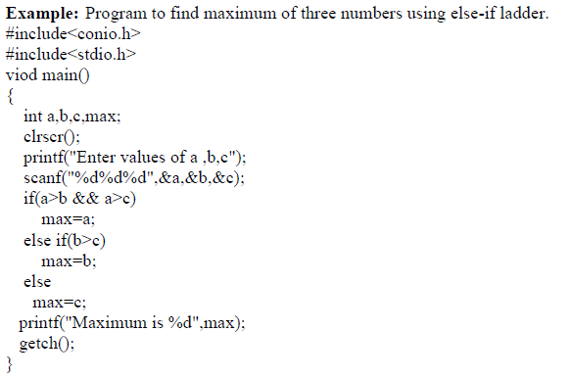
Control Structures in C
Conditional Branching Statements in C:
1. Simple if statement
2. if… else statement
3. Nested if…else statement
4. else…if ladder

Slide 22
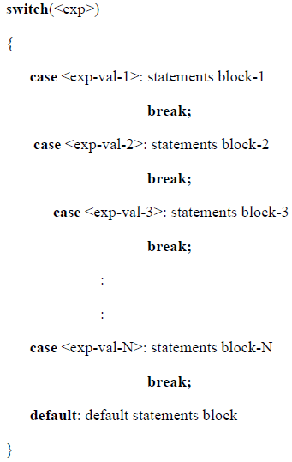
Control Structures in C
Conditional Branching Statements in C:
1. Simple if statement
2. if… else statement
3. Nested if…else statement
4. else…if ladder
5. Switch statement

Slide 23
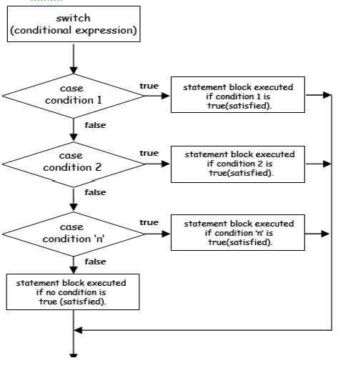
Control Structures in C
Conditional Branching Statements in C:
1. Simple if statement
2. if… else statement
3. Nested if…else statement
4. else…if ladder
5. Switch statement

Slide 24
Switch statement: Menu driven program for simple calculator
#include <stdio.h>
int main() {
char operator;
double first, second;
printf("Enter an operator (+, -, *,): ");
scanf("%c", &operator);
printf("Enter two operands: ");
scanf("%lf %lf", &first, &second);
switch (operator) {
case '+':
printf("%.1lf + %.1lf = %.1lf", first, second, first + second);
break;
case '-':
printf("%.1lf - %.1lf = %.1lf", first, second, first - second);
break;
printf("Error! operator is not correct");
}
return 0;
}

Slide 25
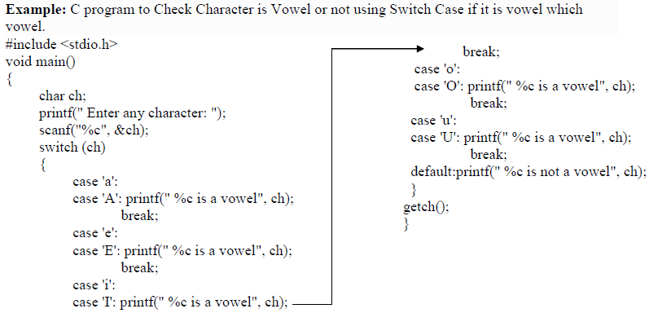
Switch statement:

Slide 26
Switch statement:

Slide 27
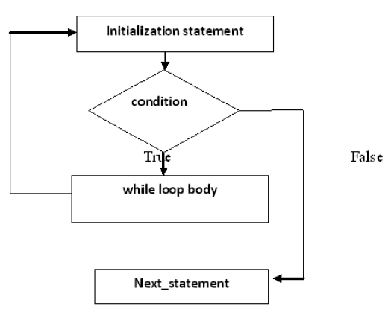
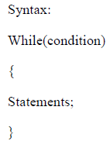
Control Structures in C
Conditional Branching Statements in C:
1. Simple if statement
2. if… else statement
3. Nested if…else statement
4. else…if ladder
5. Switch statement
6. While loop

Slide 28
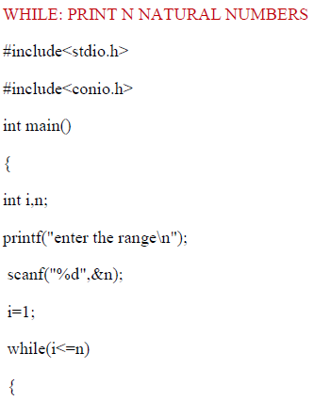
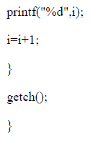
Control Structures in C
Conditional Branching Statements in C:
1. Simple if statement
2. if… else statement
3. Nested if…else statement
4. else…if ladder
5. Switch statement
6. While loop
Output= 1 2 3 4

Slide 29
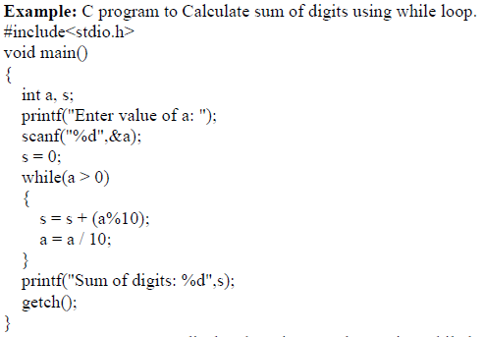
Control Structures in C
Conditional Branching Statements in C:
1. Simple if statement
2. if… else statement
3. Nested if…else statement
4. else…if ladder
5. Switch statement
6. While loop

Slide 30
Control Structures in C
Conditional Branching Statements in C:
1. Simple if statement
2. if… else statement
3. Nested if…else statement
4. else…if ladder
5. Switch statement
6. While loop
s= 0 | a = 123 | s=s+(a%10) | a=a/10
0 | 123 | 3 | 12
3 | 12 | 3+2=5 | 1
5 | 1 | 5+1=6 | 0
stop

Slide 31
Print the Fibonacci series up to given “range”
#include<stdio.h>
int main()
{
int a=0, b=1, range, c, sum=0;
printf("Enter the range of Fibonacci series: ");
scanf("%d",&range);
printf("The fibonacci series is: \t");
while( a <= range )
{
printf("%d\t",a);
c = a + b;
a = b;
b = c;
}
}
a = 0 | b = 1 | c
0 | 1 | 1
1 | 1 | 2
1 | 2 | 3
2 | 3 | 5
3 | 5 | 8
5 | 8 | 13
8 | 13 | 21
13 | 21 | 34
output for range = 9?
0 1 1 2 3 5 8

Slide 32
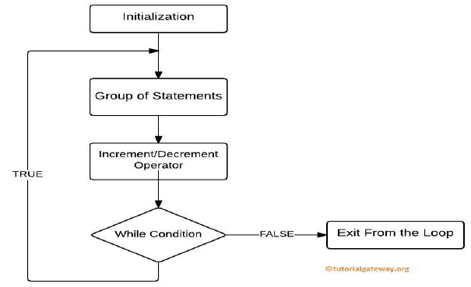
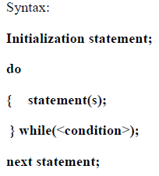
Control Structures in C
Conditional Branching Statements in C:
1. Simple if statement
2. if… else statement
3. Nested if…else statement
4. else…if ladder
5. Switch statement
6. While loop
7. Do- while loop

Slide 33
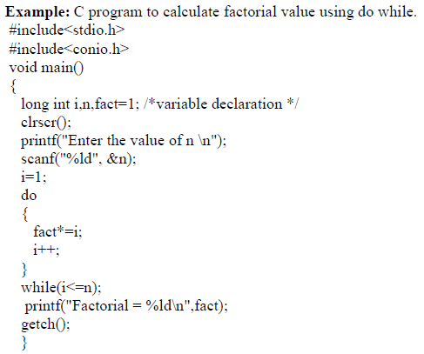
Control Structures in C
Conditional Branching Statements in C:
1. Simple if statement
2. if… else statement
3. Nested if…else statement
4. else…if ladder
5. Switch statement
6. While loop
7. Do- while loop

Slide 34
Control Structures in C
Conditional Branching Statements in C:
1. Simple if statement
2. if… else statement
3. Nested if…else statement
4. else…if ladder
5. Switch statement
6. While loop
7. Do- while loop

Slide 35
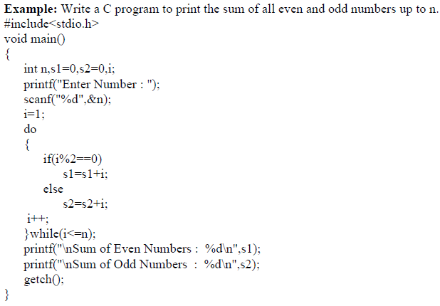
Control Structures in C
Conditional Branching Statements in C:
1. Simple if statement
2. if… else statement
3. Nested if…else statement
4. else…if ladder
5. Switch statement
6. While loop
7. Do- while loop

Slide 36
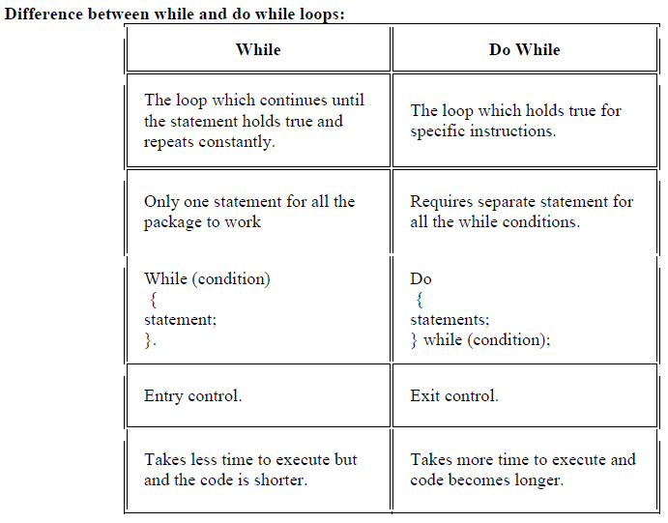
Control Structures in C
Conditional Branching Statements in C:
1. Simple if statement
2. if… else statement
3. Nested if…else statement
4. else…if ladder
5. Switch statement
6. While loop
7. Do- while loop

Slide 37
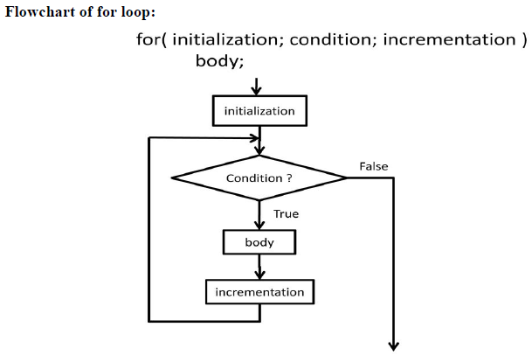
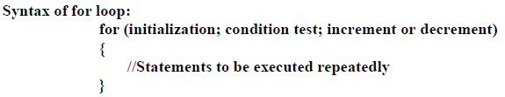
Control Structures in C
Conditional Branching Statements in C:
1. Simple if statement
2. if… else statement
3. Nested if…else statement
4. else…if ladder
5. Switch statement
6. While loop
7. Do- while loop
8. For statement

Slide 38
Control Structures in C
Conditional Branching Statements in C:
1. Simple if statement
2. if… else statement
3. Nested if…else statement
4. else…if ladder
5. Switch statement
6. While loop
7. Do- while loop
8. For statement
Print first “n” numbers using for loop

Slide 39
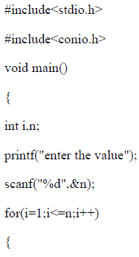
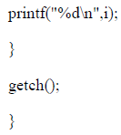
Control Structures in C
Conditional Branching Statements in C:
1. Simple if statement
2. if… else statement
3. Nested if…else statement
4. else…if ladder
5. Switch statement
6. While loop
7. Do- while loop
8. For statement

Slide 40
Print the first N terms of Fibonacci series
#include<stdio.h>
int main()
{ output for num = 9?
int a=0, b=1, num, c, sum=0;
printf("Enter the number of terms: ");
scanf("%d",&num);
printf("The fibonacci series is: \t");
for(i=1; i<=num; i++) /* prints series for n number of terms */
{
printf("%d\t",a);
sum = sum + a;
c = a + b;
a = b;
b = c;
}
}
0 1 1 2 3 5 8 13 21

Slide 41
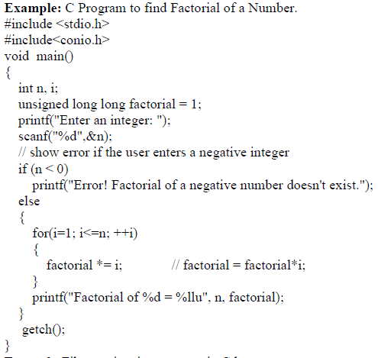
Control Structures in C
Conditional Branching Statements in C:
1. Simple if statement
2. if… else statement
3. Nested if…else statement
4. else…if ladder
5. Switch statement
6. While loop
7. Do- while loop
8. For statement

Slide 42
Various forms of for loop in C:
1) Initialization part can be skipped from loop as shown below, the counter variable is declared before the loop.
int num=10;
for (;num<20;num++)
Note: Even though we can skip initialization part but semicolon (;) before condition is must, without which you will get compilation error.
2) Like initialization, you can also skip the increment part as we did below. In this case semicolon (;) is must after condition logic. In this case the increment or decrement part is done inside the loop.
for (num=10; num<20; )
{
//Statements
num++;
}

Slide 43
Various forms of for loop in C:
3) This is also possible. The counter variable is initialized before the loop and incremented inside the loop.
int num=10;
for (;num<20;)
{
//Statements
num++;
}
4) As mentioned above, the counter variable can be decremented as well. In the below example the variable gets decremented each time the loop runs until the condition num>10 returns false.
for(num=20; num>10; num--)

Slide 44
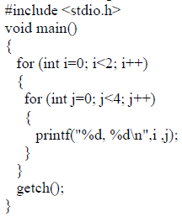
Nested For Loop in C:
Output ?

Slide 45
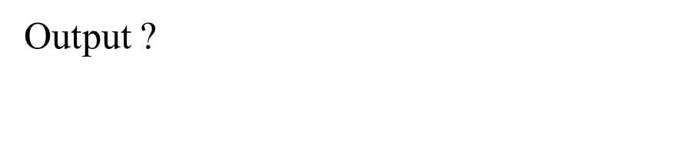
for (int i = 1; i <= rows; i++)
{
// inner loop 1 to print white spaces.... 1 to 2*(3-1)= 1 to 4
for (int j = 1; j <= 2 * (rows - i); j++)
{
printf("*");
}
// inner loop 2 to print numbers.... k= 1 to 2*3= 1 to 6
for (int k = 1; k < 2 * i; k++)
{
printf("%d ", i);
}
printf("\n");
}

Slide 46
Nested For Loop in C:
Step 5: write logic for sorting elements in the array
for(i=0;i<n-1;i++)
{
for(j=0;j<n-1-i;j++)
{
if(arr[j]>arr[j+1])
{
temp=arr[j];
arr[j]=arr[j+1];
arr[j+1]=temp;
}
}
}

Slide 47
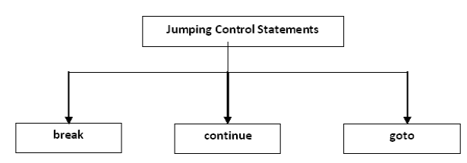
Jumping control-flow statements.
Jumping control-flow statements are the control-flow statements that transfer the control to the specified location or out of the loop or to the beginning of the loop. There are 3 jumping control statements:

Slide 48
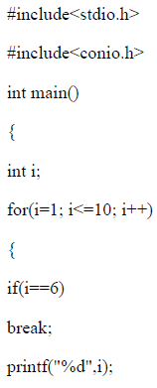
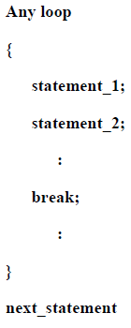

Jumping control-flow statements.
The “break” statement is used with in the looping control statements, switch statement and nested loops. When it is used with the for, while or do-while statements, the control comes out of the corresponding loop and continues with the next statement.

Slide 49
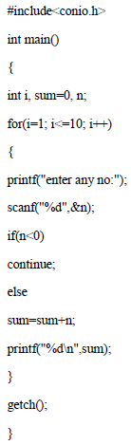
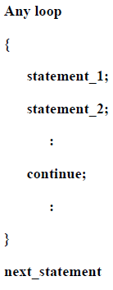
Jumping control-flow statements.
A continue statement is used within loops to end the execution of the current iteration and proceed to the next iteration. It provides a way of skipping the remaining statements in that iteration after the continue statement.

Slide 50
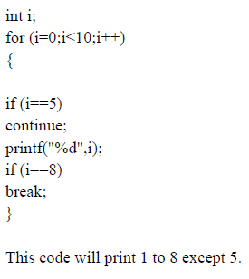
Jumping control-flow statements.

Slide 51
Jumping control-flow statements.

Slide 52
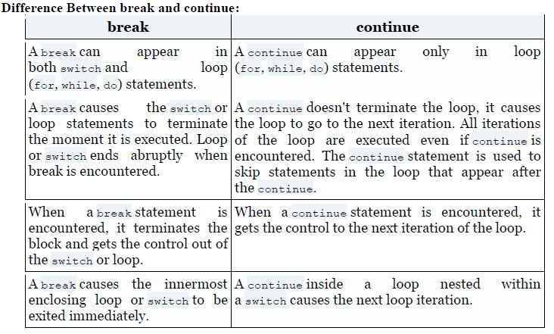
Jumping control-flow statements.

Slide 53
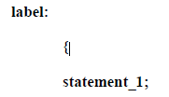
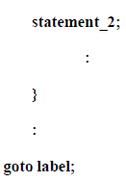
Jumping control-flow statements.
The goto statement transfers the control to the specified location unconditionally. There are certain situations where goto statement makes the program simpler. For example, if a deeply nested loop is to be exited earlier, goto may be used for breaking more than one loop at a time. In this case, a break statement will not serve the purpose because it only exits a single loop.
In this syntax, goto is the keyword and label is any valid identifier and should be ended with a colon (:).
The identifier following goto is a statement label and need not be declared. The name of the statement or label can also be used as a variable name in the same program if it is declared appropriately.

Slide 54
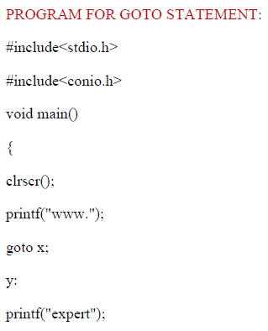
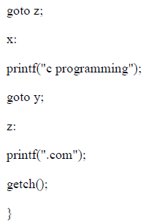
Jumping control-flow statements.

Slide 55
